Slide 1
Life in the roman army

Slide 2
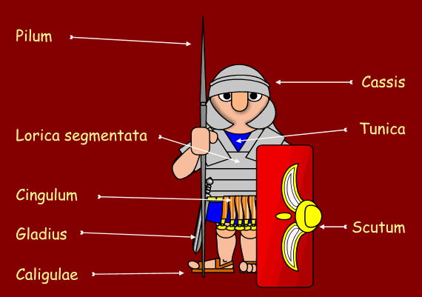
Equipment for soldiers
Weapons
Food
Armour
Other

Slide 3
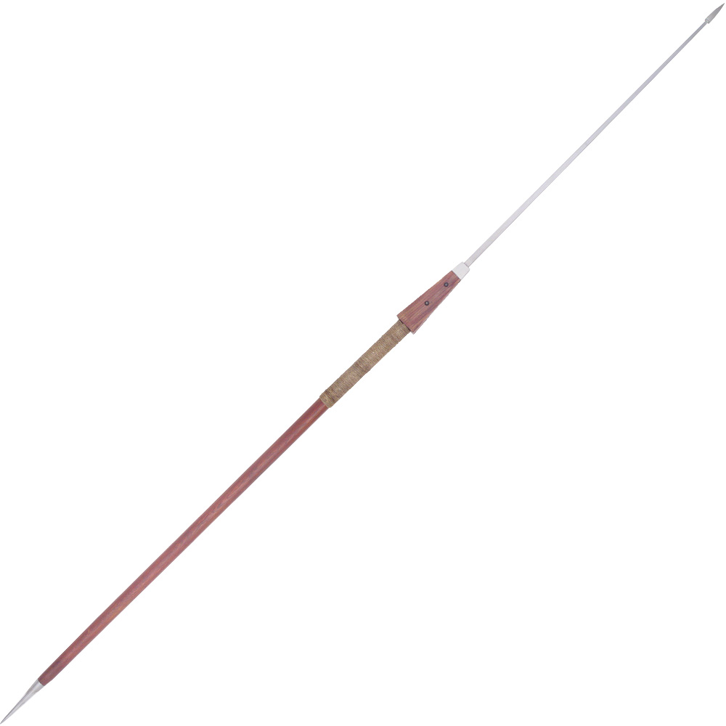
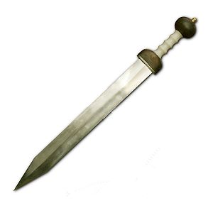
Weapons
Pilum (spear)
Gladius(sword)

Slide 4
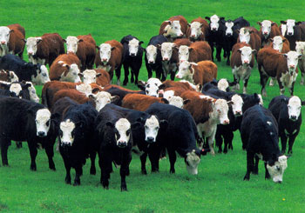
Food
Bread, Meat, Cheese, bacon.
Wine
Mobile food source
Stole

Slide 5
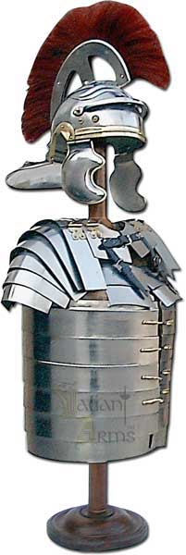
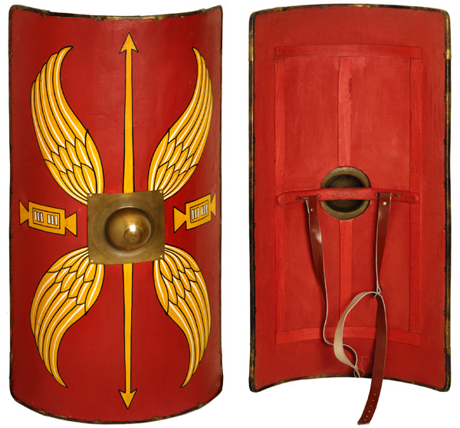
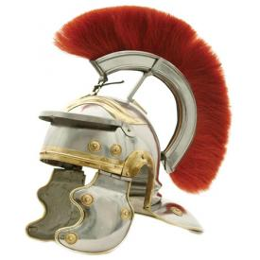
Armour
Scutum
Lorica segmentata
Cassis

Slide 6
Other
Soldiers had to carry their impedimenta with them which was everything from weapons to tents.

Slide 7
Training
Life was tough for soldiers, they had to march 20 miles each day with all their armour and equipment!

Slide 8
ANY QUESTIONS?

